Slide 1
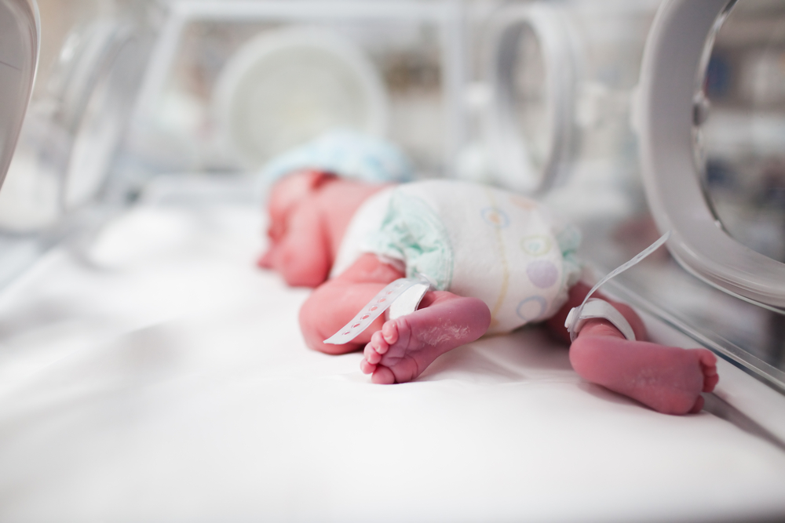
PRE TERM LABOUR

Slide 2
Objectives
To define pre term labour
To describe incidence
To describe risks
To identify risk factors
To screen for preterm labour
To discuss diagnosis
To discuss management
To discuss prevention

Slide 3
Definition Labour starting spontaneously after 24 -28 weeks and before 37 completed weeks of gestation

Slide 4
Incidence Range between 5-10%

Slide 5
BURDEN
Fetal :- Bowel- Necrotising Enterocolitis→ due to poor blood flow→ Needs I/V antibiotics and intravenous feeding.
Immature Gastro-intestinal and digestive system
Brain – Intraventricular Haemorrhage
Cerebral Palsy
Lungs –Immature lungs (lack of surfactant ) → RDS ( Harsh irregular breathing)
Transient tachypnoea
Bronchpulmonary Dysplasia
Pneumonia
Apnoea and bradycardia

Slide 6
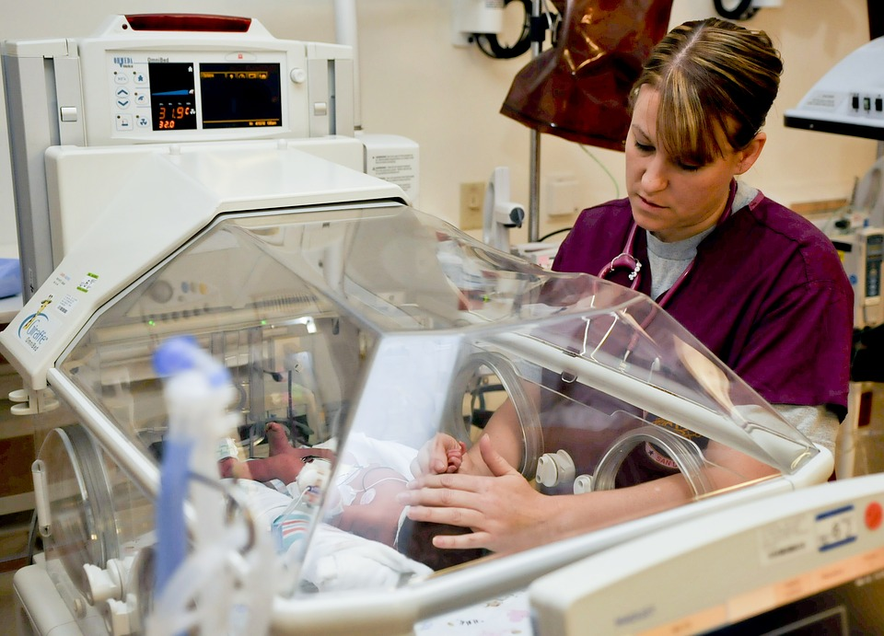
BURDEN
Sepsis- Often results in pneumonia
Neonatal care – Immature skin and little body fat→ Hard to maintain body heat→need incubator care.
Retinopathy of prematurity.
Maternal :-Medication
Surgical risk
Cost to health care

Slide 7
Risk factors
Previous pre term birth(between 16 -36 weeks)
maternal-poor nutrition/social disadvantage
Anaemia
Law pre pregnancy weight
Smoking
Diabetes mellitus
Hypertension
Cervical surgery
Congenital anomalies of uterus
Current pregnancy-Multiple pregnancy
Infections
Mode of conception

Slide 8
Pre pregnancy care
Identify and correct risk factors
Pre pregnancy folic acid
prevent spina bifida
prevent preterm birth
increase birth weight
reduce cardiovascular anomalies

Slide 9
Pathophysiology
Cervix-Cervical insufficiency
Uterus-Preterm uterine contraction
Membranes-Chorioamnionitis

Slide 10
Fetal Inflammatory stress syndrome
CRH
ACTH
Cortisol
Activation of common pathway

Slide 11
Aetiology
Preeclampsia
Antepartam haemorrhage
Polyhydroamniosis
Acute fever –Pyelonephritis
Acute appendicitis
Genital tract infection-
Bacterial vaginosis
Chlamydia
Mycoplasma
?GBBS

Slide 12
Fetal
Multiple pregnancy
Congenital malformation
Intrauterine death

Slide 13
Placental
Infarction
Thrombosis
Placenta praevia/abruption

Slide 14
Clinical evaluation
Symptoms Examination Investigation

Slide 15
Presentation
Preterm labour:
SROM
Painless dilatation of cervix
Contractions 1 in 10 min painless/ painful
intermittent abdominal cramping
pelvic pressure
Backache
increase vaginal discharge
vaginal spotting /bleeding

Slide 16
Examination
Pulse
Blood pressure
Temperature
Abdomen- lie ,presentation ,contraction

Slide 17
Sterile speculum examination
Looked liquor
PH
Fibronectin(FFN)swab-posterior fornix
external cervical os
HVS-chlamydia(cervix),
N gonorrhoea(cervix)
Group B streptococcus(outer 1/3 of vagina and perineum)

Slide 18
Cervical assessment
Effacement 80%
Dilatation >2 cm

Slide 19
Investigations
UFR
CRP
FBC
OGTT
CTG

Slide 20
USS
Placental location
AFI
fetal weight
Presentation
fetal wellbeing

Slide 21
Cervical ultrasound
Cervical length<20mm+Contractions:PTL
20-30mm+contractions:probable PTL >30mm:PTL very unlikely

Slide 22
Management
Rest left lateral position
Sedation
Hydration
Antibiotics-Erythromycin 250mg tds 10 days

Slide 23
Tocolysis
Nifedipine
Acute tocolysis : Nifedipine 20mg every 20mins,5 doses to delay delivery by 24 hours for steroid to act

Slide 24
Glucocorticoid therapy
Betamethazone 12mg 2 doses 1 hourly
Dexamethazone 8mg 3doses 8 hourly

Slide 25
Reassure
Continue monitoring
Look for infection-Pulse rate (PR)
Respiratory Rate (RR)
QHT
serial CRP/ FBC every other day
Look For Cord prolapse

Slide 26
Neonatologist
Discuss with the mother
- outcome
- complications
- neonatal care

Slide 27
Delivery
Avoid asphyxia
Avoid birth trauma
Avoid Cerebral palsy

Slide 28
Recurrent infections
Before 34 weeks,
MgSO4 4 g stat dose and 1g per hour infusion starting at least 4 hours before delivery and continue until delivery.

Slide 29
Mode of delivery
Vaginal
- cephalic
- No vacuum before 34 weeks
- wide episiotomy

Slide 30
Diagnosis of SROM
History
Examination- Sterile speculum for pooling
If no pooling seen perform
- Insulin like Growth factor binding protein -1 test
or
- Placental alpha microglobulin -1 test
- USS for liquor volume

Slide 31
Thank You

